Slide 1
Seek First to Understand, then to be understood
You have two ears and one mouth
By: Danny, Allen, ali, Soucory.

Slide 2
Habit 5
This habit is very common..
Because us teens like to be the center of attention.
Thus causing us to talk and talk without listening causing us not to have good communication.

Slide 3
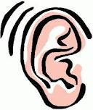
Habit 5
You have two ears and one mouth.
In other words if you want to talk listen first.

Slide 4
Its not you
Don’t be selfish listen to other people to
Some people don’t like it when you are all moth and no ears.
Its best to listen the to be heard on most occasions.

Slide 5
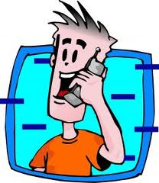
Talking
Its good to talk it helps to get stuff off you mind, but talking to much can be a bit annoying.
So when your talking remember to do your best to listen.

Slide 6
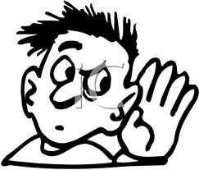
listen
Listening is better than talking.
Remember don’t just listen its good to speak when you want.
Therapist have good practice in this because they listen and THEN speak about it.

Slide 7
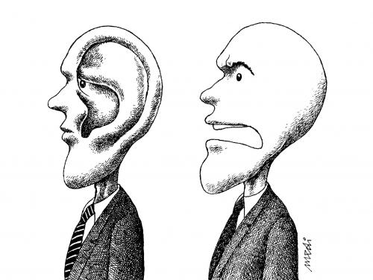
Good times when to speak and when to listen
You should always listen when someone who has a problem .
remember listening is better than speaking.

Slide 8
Lets recap
Listening is good.
Speaking is good when your not listing
You have TWO ears and ONE mouth
REMEMBER THIS AND YOU SHOULD BE ABLE TO BREAK THIS HABIT

Slide 9
THE END
This video was created by these producers:
Danny Price
Ali abdel hamid
Soucory bruce
Allen martin

